Slide 1
Welcome!
Please, have a seat.
CWRU Quants
quants@case.edu
Notes:
CHristo

Slide 2
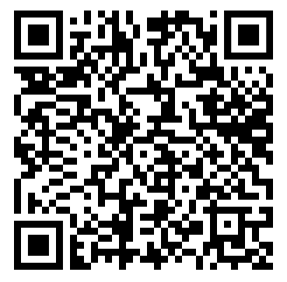
Cohort Applications due next Friday!
Notes:
Important to note WHERE all these types of contracts come from: mostly because people want a way to make money

Slide 3
AGENDA
Intro to Options
Build a Payoff Diagram Example
Intro to Greeks
Market Microstructure
Case Study: Jane Street India
Notes:
Christo

Slide 4
Intro to Options
Notes:
Christo

Slide 5
First An Interesting History Lesson…
Thales of Miletus secured the first ever options contract in 600 BC.
Forsees a larger harvesting season for olives, so in the offseason purchases the right but not the obligation to rent out olive presses from the press owners.
When the harvesting season came he exercised his option and rented out the olive presses at a much higher price and pocketed the difference.
Notes:
Important to note WHERE all these types of contracts come from: mostly because people want a way to make money

Slide 6
What is an Option?
An option is a financial contract wherein the holder of the contract has the right but not the obligation to buy or sell an underlying asset or financial instrument at a specified strike price on or before a specified date, depending on the form of the option.
Strike price is the fixed price of the asset at which the holder has the right to buy or sell the underlying asset.
Expiry Time is the predetermined time at which the obligations must be honored by, otherwise the contract is invalid.
Notes:
Everyone

Slide 7
Put vs. Call
In general terms there are really two kinds of options.
Put: Gives the holder the option to sell at the given strike price.
Call: Give the holder the option to buy at the given strike price.
American vs. European
American: Option variant that allows for execution before expiry.
European: Option variant that only allows for execution at expiry
*There are also exotic options which is a catch-all for “weird” variants of options
Notes:
Explain briefly exotics more broadly before making the final point

Slide 8
An Example
We consider a European Call Option on some security that we have purchased for 5$
Current Price of Security: 50$
Strike Price of Security: 50$
Price of Security at expiry: 70$
payoff = max(Expiry-Strike, 0)=70$-50$=20$
profit = payoff-premium=20$-5$=15$
Notes:
make the point that if price at expiry was say 40$, then you would not exercise the option and would rather just take the 5$ hit

Slide 9
How do firms profit?
HFT firms will have some “theoretical value” that is based on their own models for option pricing: Black-Scholes-Merton, Binomial, Heston, Monte-Carlo, Finite Difference, etc..
These can make different assumptions, have closed or numerical forms, among many other differences.
The firm will send a bid below this theoretical value and an offer above that value, these will be fulfilled by other market participants.
Once some participants have executed on these offers/bids, the firm will pocket the difference between the theoretical value and this executed value.
Notes:
Emphasize that there are MANY MANY ways to make money off options, this is what quant researchers do

Slide 10
How do firms profit? pt. 2
There are thousands, millions of these trades executed and even if you pick up a fraction of a cent on each trade, you’re in the profit.
You don’t even have to correctly price the option at expiry, in fact you can price it incorrectly and still profit.
There are many, many different ways to profit from options, this is perhaps the most common
Ex: We buy an option for 1.00$ and do no other trades with that option besides later selling it for 1.04$, the option then expires worth 0$. Notice: We made 0.04$ but the option expires worthless.
Notes:
Everyone

Slide 11
Payoff Diagram
Notes:
Christo

Slide 12
What is a Payoff Diagram?
A visual representation of how the value of an option (or strategy) changes at expiration.
X-axis = Underlying asset price at expiry.
Y-axis = Profit or payoff from holding the option. Helps traders and students see risk and reward clearly:
Maximum loss (often limited to premium paid).
Break-even point.
Profit potential (limited or unlimited depending on strategy)
Notes:
Explain briefly exotics more broadly before making the final point

Slide 13
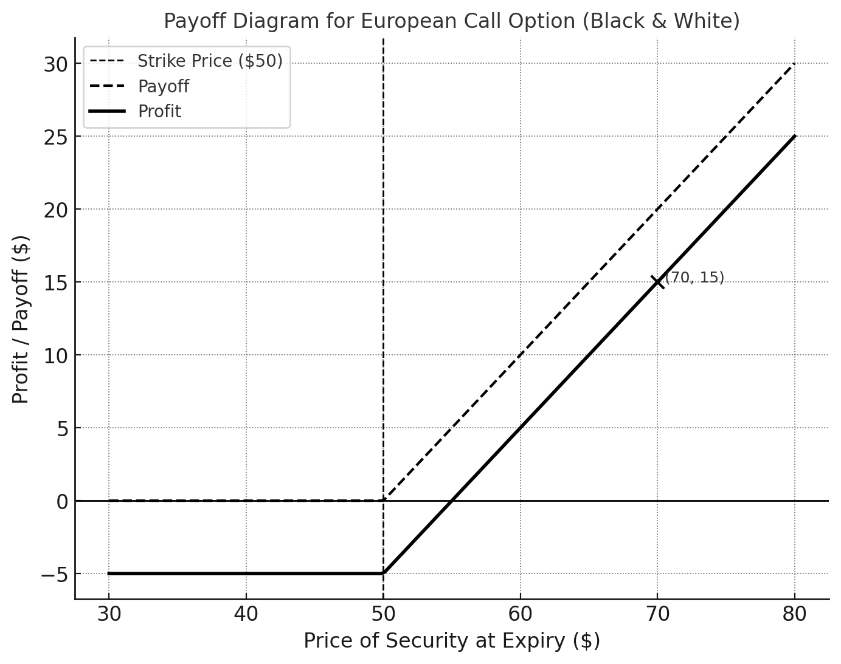
Helps traders and students see risk and reward clearly:
Maximum loss (often limited to premium paid).
Break-even point.
Profit potential (limited or unlimited depending on strategy)

Slide 14
Intro to Greeks
Notes:
Gus

Slide 15
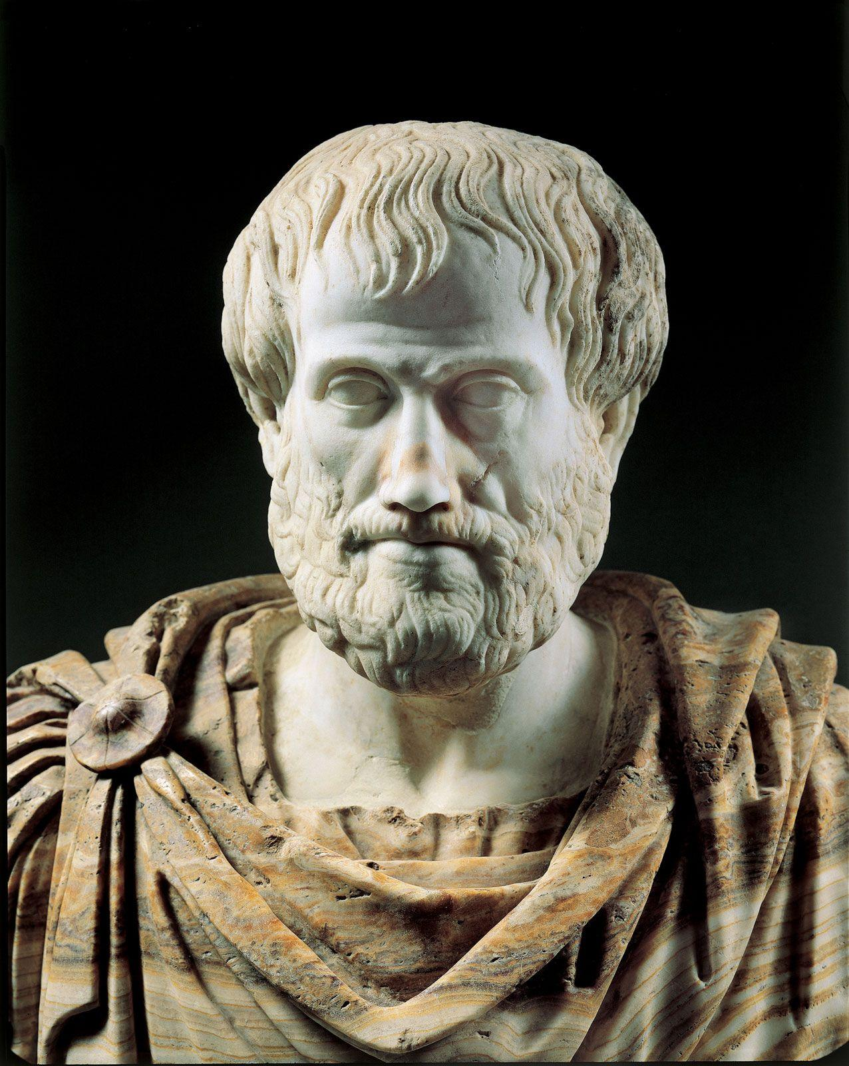
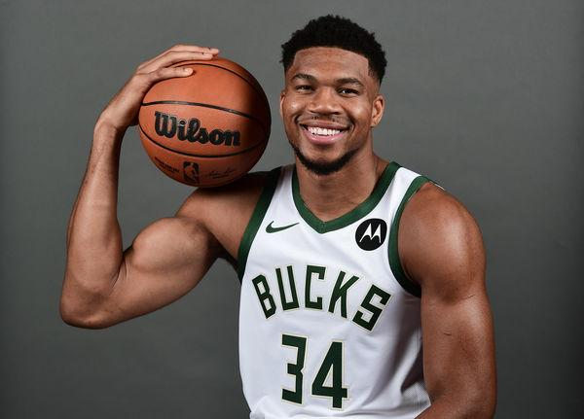
What are “the Greeks?”
QF uses Greek letters to talk about how sensitive an asset is (often options) to underlying parameters
Greeks are very useful when talking about risk

Slide 16
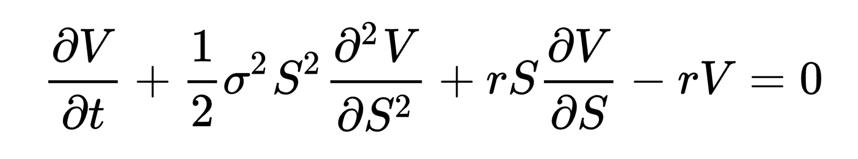
Some Context: The Black-Scholes Model
The most basic Greeks are ⍺ and 𝛃
𝛂: return on investment relative to overall market
𝛃: measures risk of an asset relative to the risk of the overall market risk
𝛃>1 implies that the asset is more risky than the market
Black-Scholes Equation is commonly used, and it’d be nice to have names for these quantities

Slide 17
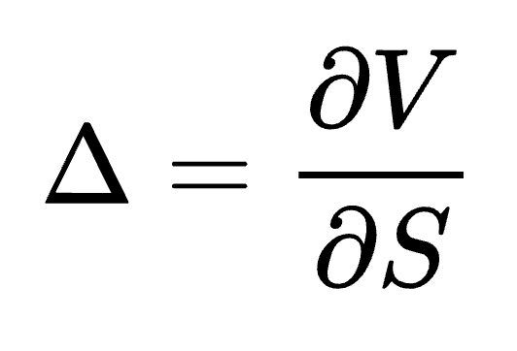
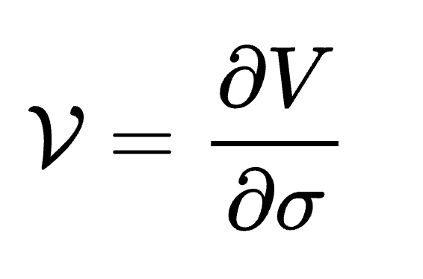
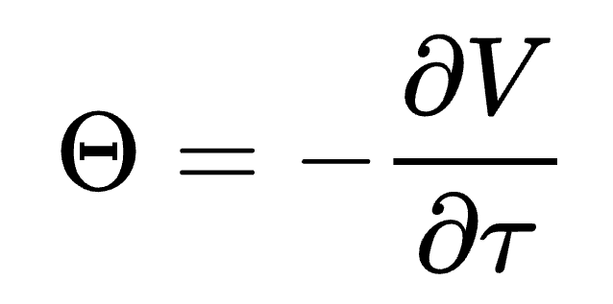
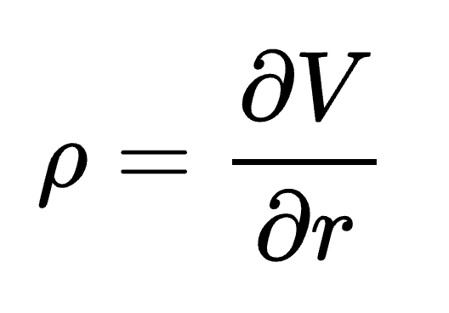
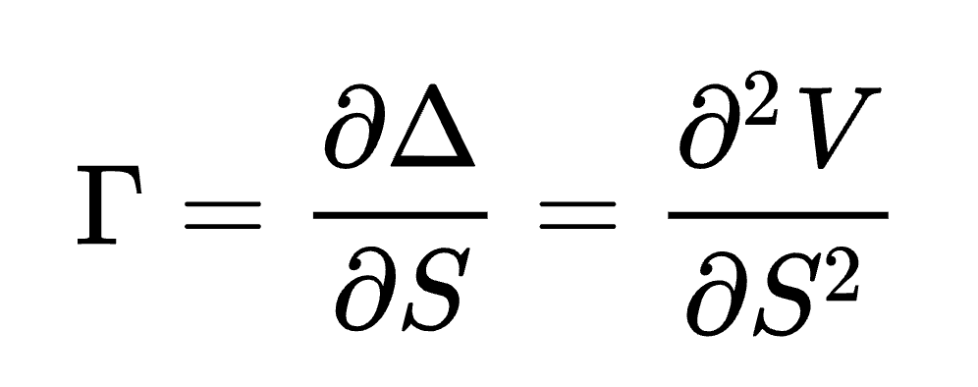
Delta: Rate of change of option value to underlying asset’s price
Important Greeks to Know
Vega: Sensitivity of option value to volatility of underlying asset
Define V as the value of the option, S as the underlying instrument’s price, 𝜎 as its volatility, and t as time until expiration.
Theta: Sensitivity of value to time
Rho: Sensitivity of value to the interest rate
Gamma: Rate of change of delta to changes in the underlying price

Slide 18
Market Microstructure
Notes:
Gus

Slide 19
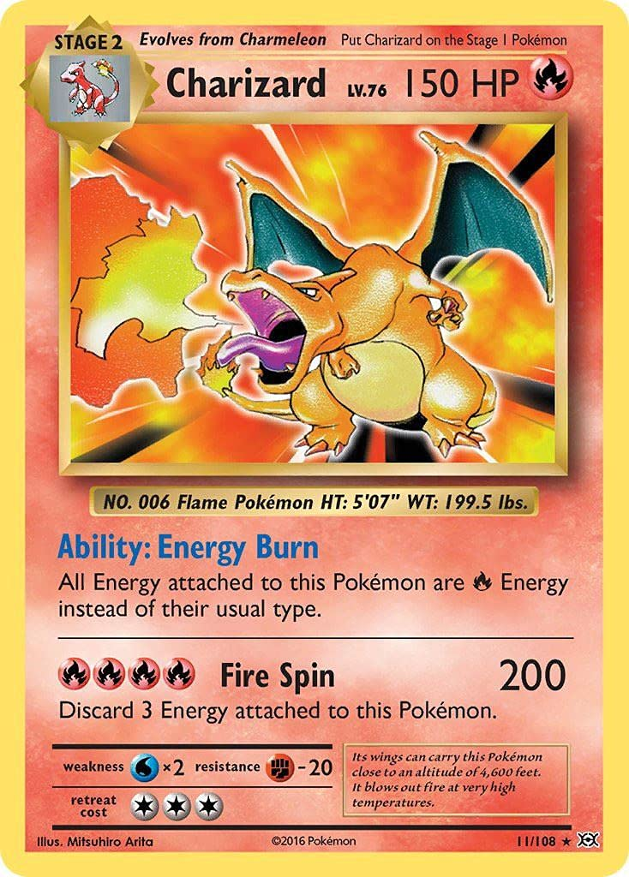
Liquidity
Liquidity can be determined by how much buying and selling power is available in the market, also known as market depth
Buying and selling power - cash available, trade execution speed, trading volume
Stock market - Huge buying and selling power, very liquid
Collectible trading cards - Lower buying and selling power, illiquid
In illiquid markets, the price that you see isn’t necessarily the price you get - more volatility

Slide 20

Liquidity - contd.
General hallmarks of different levels of liquidity
High liquidity - high trading volume, high competition, easy access
Low liquidity - low trading volume, high volatility
Notes:
High Trading Volume - Strong demand and large pool of buyers and sellers High Competition - Traders and market makers competing for the better prices Easy Access - Ability for someone with no experience in the market to get in
Volatility - Frequency of change

Slide 21
Bids and Asks
Liquidity on both buy- and sell-side of the market
Bid price - maximum price a buyer is willing to pay
Ask price - minimum price a seller is willing to receive
The difference between bid and ask price is known as the spread
Generally, markets with low spread are more liquid than markets with higher spread (?)
Notes:
Ask what is a market with low spread and low liquidity. ANS - A market with high buyer interest but low trading volume, such as a small cap stock has a major announcement

Slide 22
Basic Order Types
Market Order - Buy/sell for the best possible price now
Limit Order - Buy/sell at only this price or better
Stop Order - Specifies the price at which to execute a market order

Slide 23
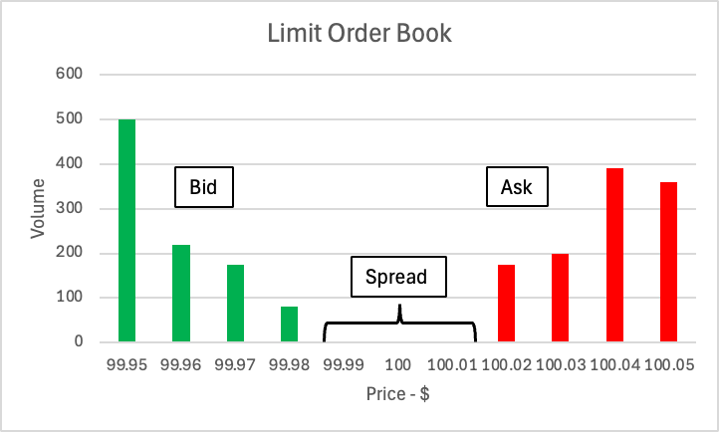
Limit Order (LO)
Passive order that guarantees price or better
Buy - price or lower, Sell - price or higher
Limit orders are executed as other orders can fulfill its requirements - doesn’t have to be all in one go
The collection of buying and selling limit orders at any time make up the Limit Order Book (LOB)

Slide 24
Market Order (MO)
An active order which is executed based on the best available price of all limit orders
Action of going through each level of the LOB is called “walking the book”
The market order is not fulfilled until the quantity has been matched or no limit orders remain (very rare)

Slide 25
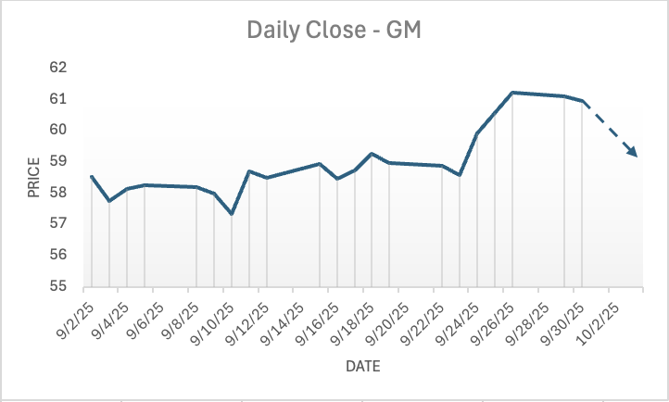
Stop Order (SO) AKA Stop-Loss
Passive order that transforms into an active order when conditions are met, guaranteeing execution but not price
The trigger is when the market price of the assets reaches the stop price
Usually used to mitigate loss on an investment, hence the name
Difference between SO and LO is in the guarantee. LO guarantees price, SO guarantees execution

Slide 26
Relation to Derivatives
Since the LOB is one of the factors in determining current stock price, the distribution of Limit Orders also affects derivative pricing
If you were to place a large market order this would increase volatility which increases the value of the option derived from the stock
When stop order thresholds are triggered, this can also lead to huge swings that affect value of options

Slide 27
Jane Street India Situation
Notes:
Christo

Slide 28
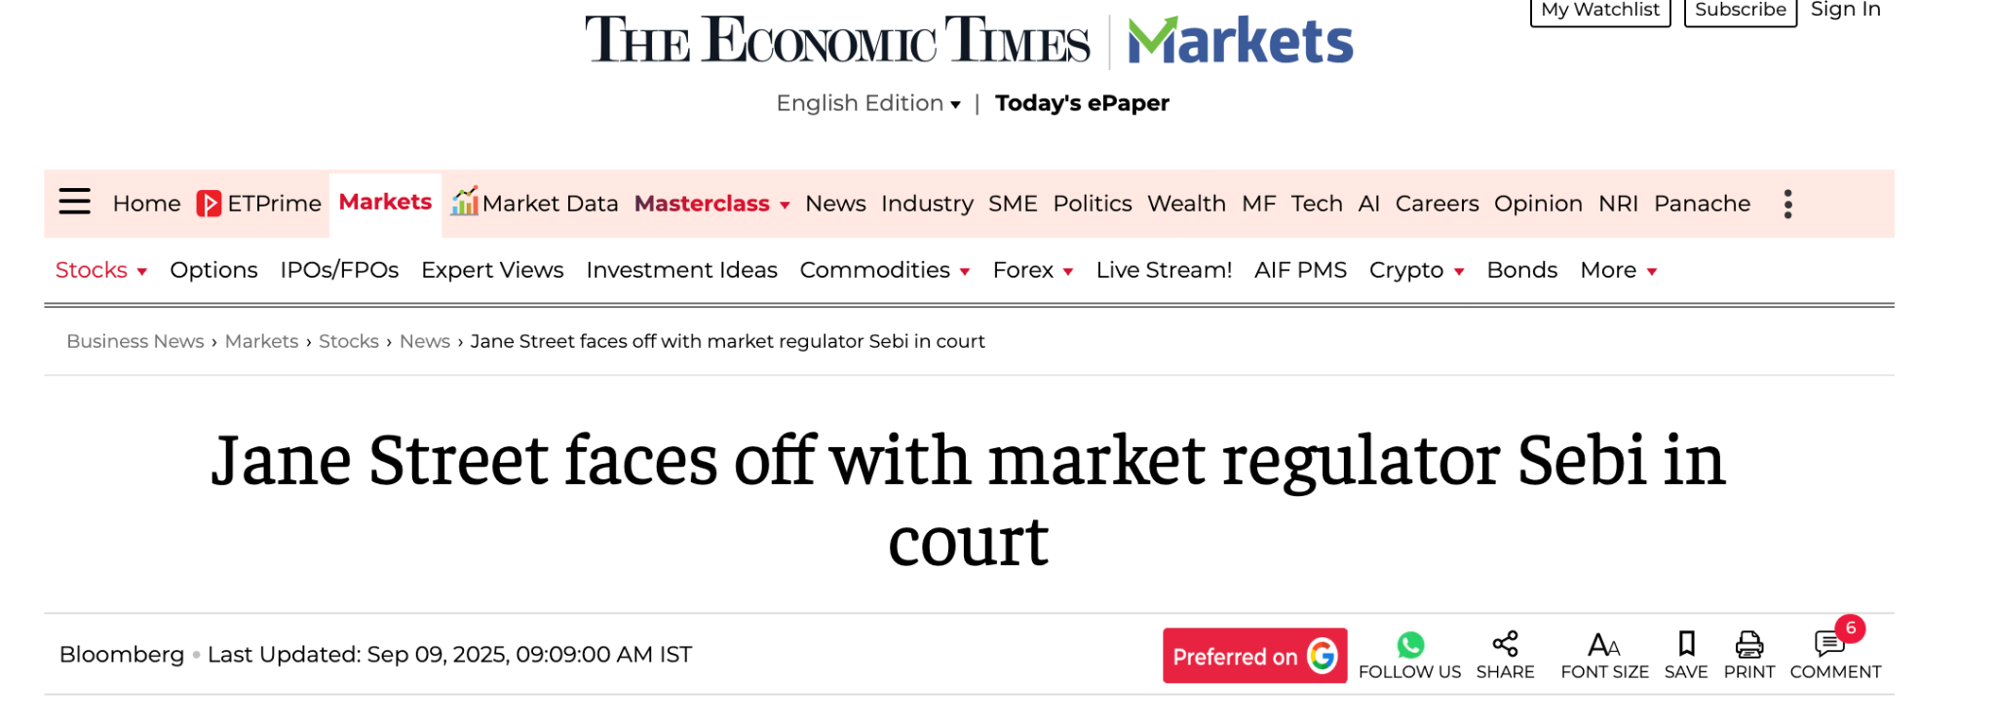
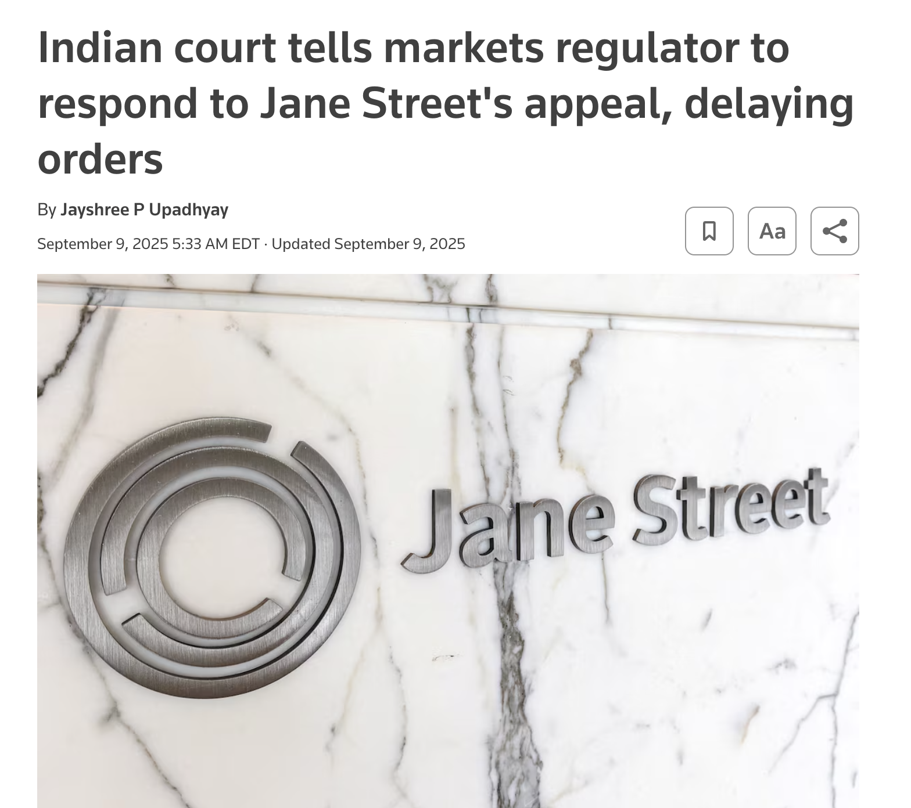
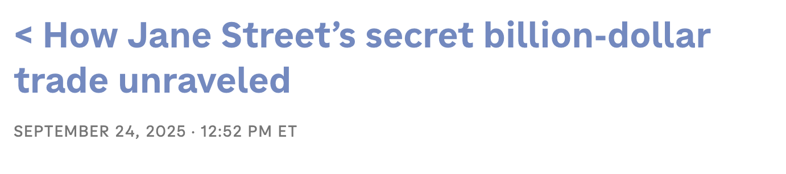
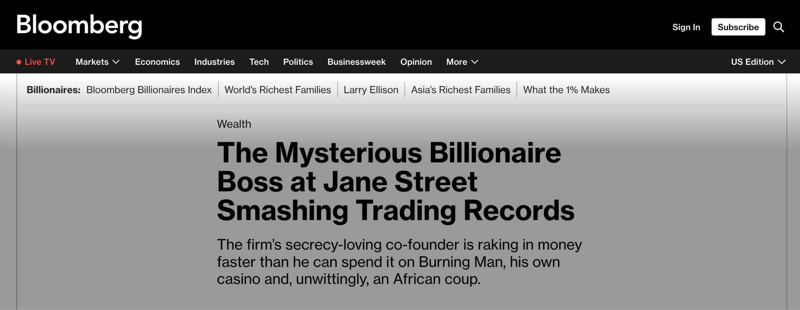
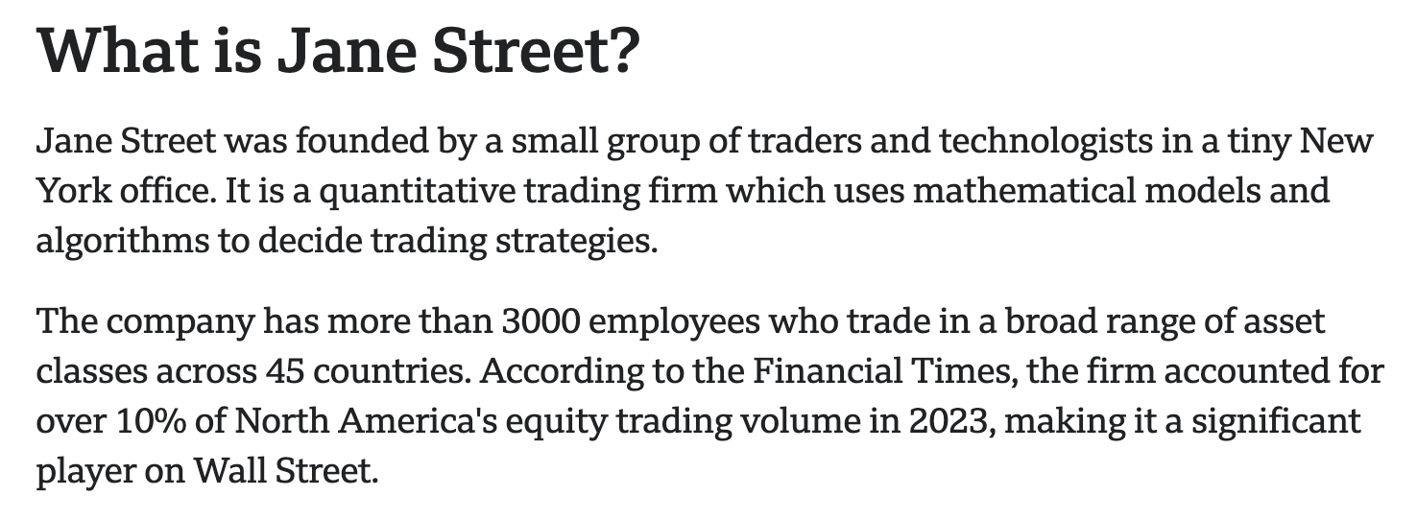

Slide 29
In August, India’s financial regulator SEBI (Securities Exchange Board of India) accused Jane Street of exploiting derivative market, and then banned them from the Indian Markets
Jane Street denied these charges, and says that it was merely engaging in “standard arbitrage strategies”
But what’s really going on?

Slide 30
India’s Stock Market
Derivatives turnover in India is more than 300x higher than cash turnover
For much of the 2000s, India’s markets were very dry
getting leverage for trades extremely difficult
combination of high transaction costs, bad infrastructure, kept most people (and firms) away, tax on every trade
This caused many people to turn to options trading
As we just learned, options allow you to gain exposure to massive gains (and losses) without owning the underlying stock
if you are taxed on a percentage of the shares you buy/sell no matter the profit, the citizens preferred to trade options for potentially higher profits (with higher risk)

Slide 31
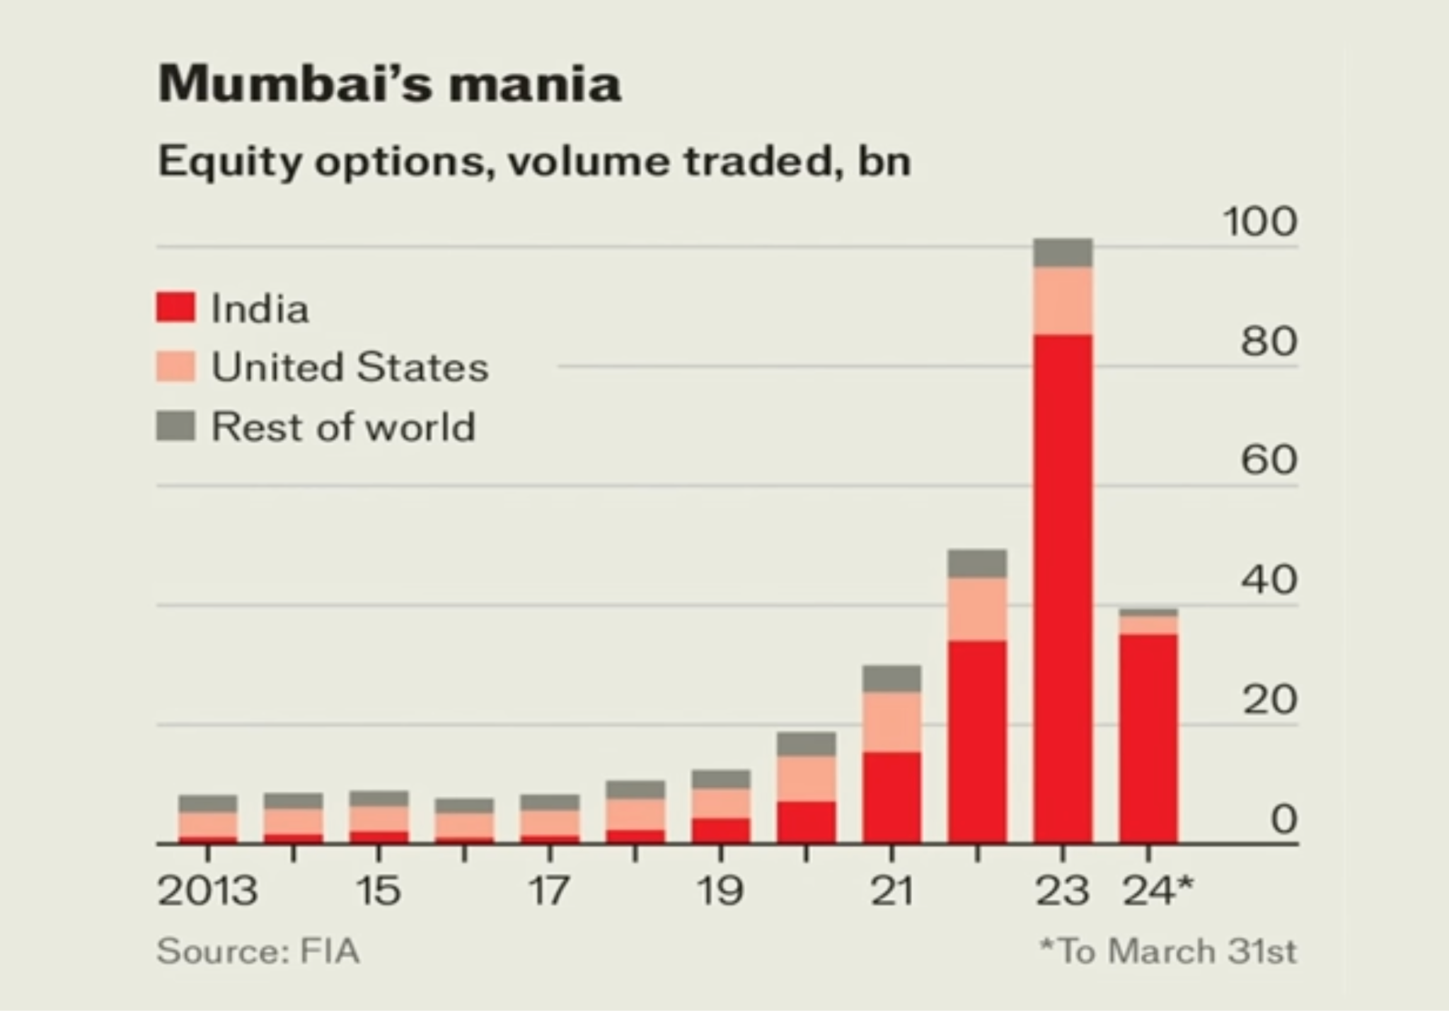
Relation to Derivatives

Slide 32
Introduction of 0 Days To Expiration Options quickly became popular in India, especially amongst the youth
9/10 retail traders are losing money in the markets
over the last 4 years, mom and pop traders have lost a combined $33 billion USD
Seen as adjacent to America’s “meme stock craze” (remember Gamestop?)
High risk -> super high reward

Slide 33
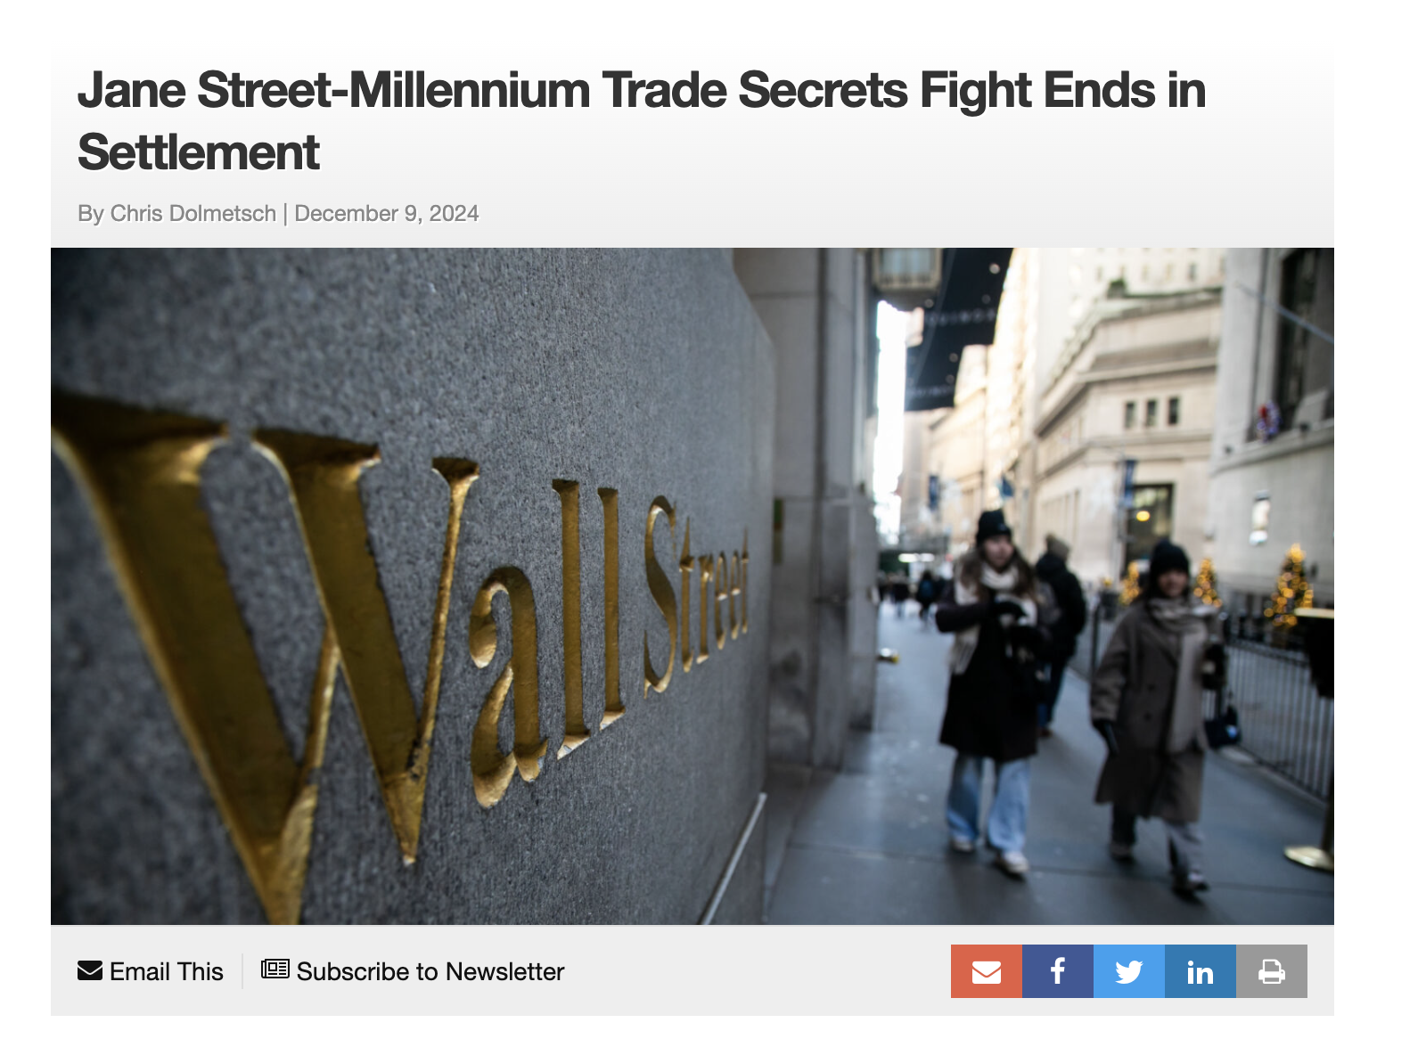
August 2024, Millennium hired 2 ex Jane Street traders, and it was revealed that the employees had leaked a proprietary trading strategy based around the Indian market
This caused SEBI to begin investigating the action in their own markets… Who wouldn’t be concerned?

Slide 34
Intraday Index Manipulation
Focuses on 0DTE options on BANKNIFTY (regional bank)
Alleged scheme had 2 phases
Phase 1: JS aggressively buys shares and futures of BANKNIFTY, which are significant quantities in relation to the trading volumes in the markets. These purchases are so aggressive that they push up the price of the underlying stock
At the same time (presumably after price adjustment), they buy cheap put options and sell call options
Phase 2: JS dumps all of their shares and futures, which also affects the price. This causes their puts to skyrocket in price, and the calls they sold to plummet.

Slide 35
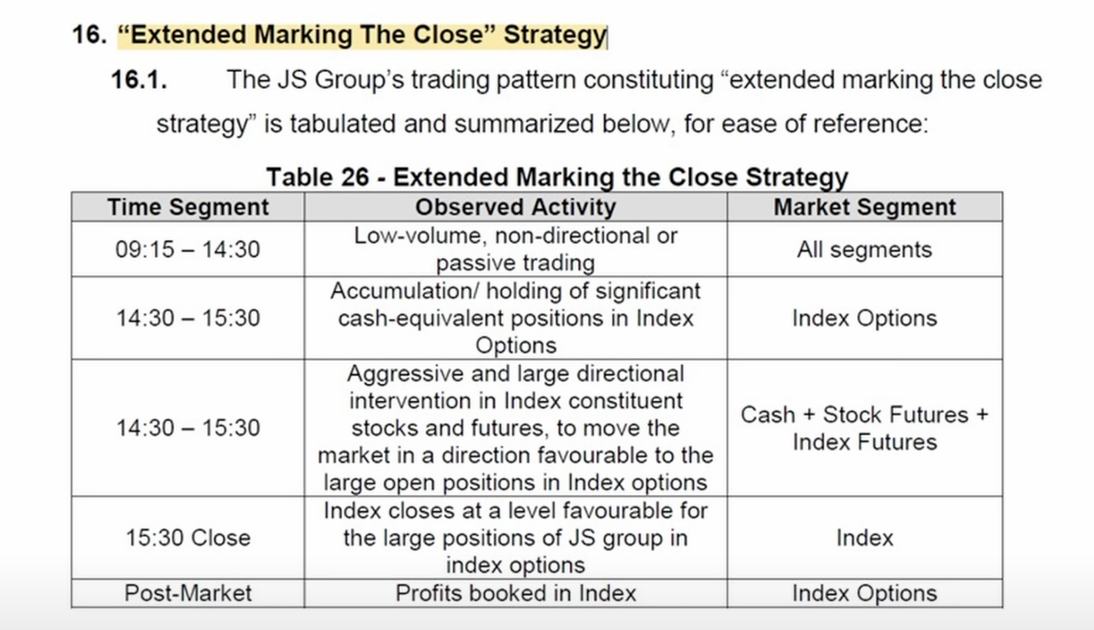

Slide 36
Intraday Index Manipulation
Jane Street ended up losing money in the cash and futures market, but made massive gains in the derivative market
In the trading day that SEBI used to accuse JS:
across 8 minutes, JS bought up $67 million of NIFTY
lifted the index over 1% across the course of the buying spree
argued that these losses were “unjustifiable” and were taken “only to distort NIFTY option prices”
Jane Street’s response….

Slide 37
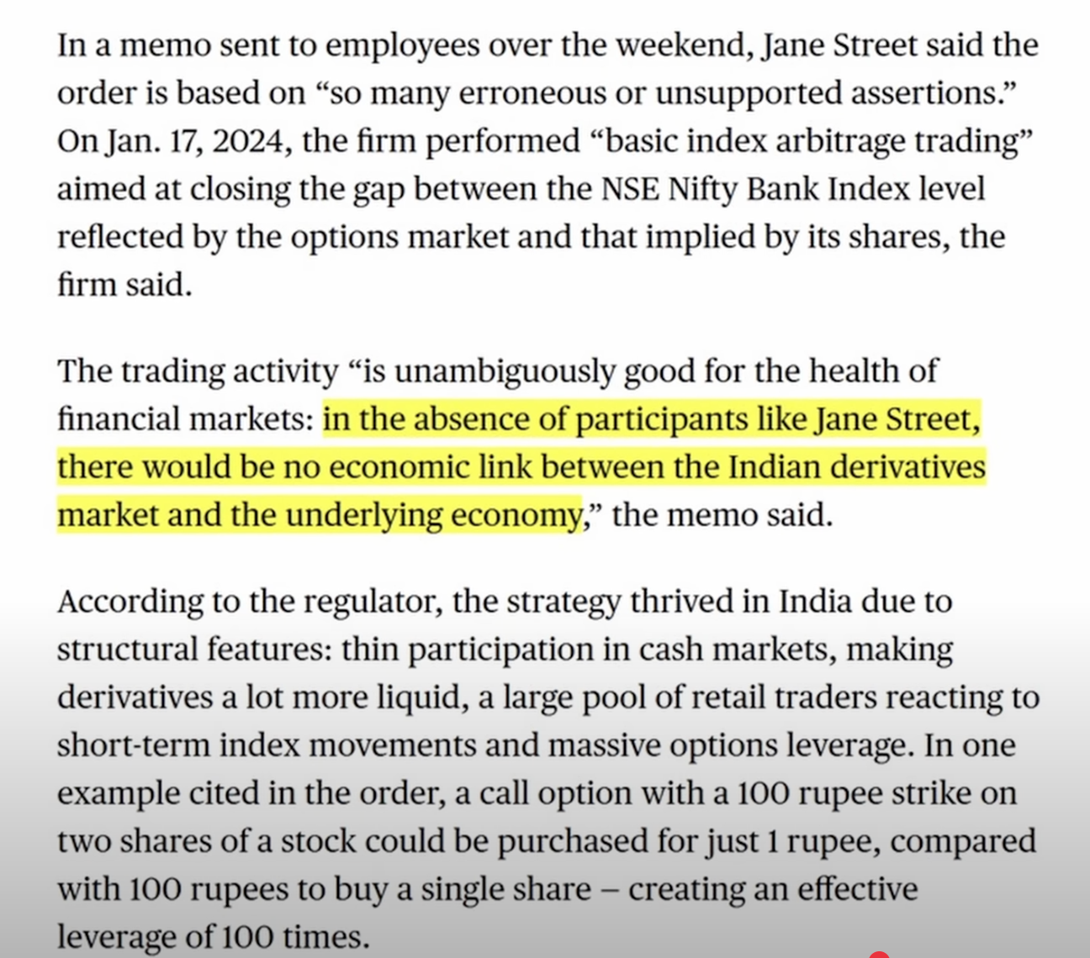

Slide 38
In summary: Jane Street took advantage of this, and generated more than $4.3 billion in gains since 2020
Options vs underlying imbalance creates a market where (expiry) price movements can be influenced by movements in the underlying stock
Jane Street vs. SEBI revealed one aspect of JS’s trading strategy in foreign markets.
we talked previously about market efficiency

Slide 39



Social Links
@cwruquants
@cwruquants
@cwruquants
Notes:
CHristo

Slide 40
QUESTIONS
AND ANSWERS
Contact us!
Email: quants@case.edu
Instagram: @cwruquants
Notes:
Sid

